Slide 1

EAHIL
Being a member of the EAHIL Council
European Association of health &information librarians
Eahil.eu

Slide 2
Being a member of the EAHIL Council
As an EAHIL Council member, skills needed are commitment, vision, enthusiasm, communication, and interpersonal skills.
A commitment to EAHIL as an organisation, its objectives, and values. Vision for EAHILs future and enthusiasm for new ideas and activities. It is important for the Council member not only to communicate with their members but show interpersonal skills e.g. actively listening to other EAHIL members, building lasting relationship and motivating others to participate in EAHIL.

Slide 3
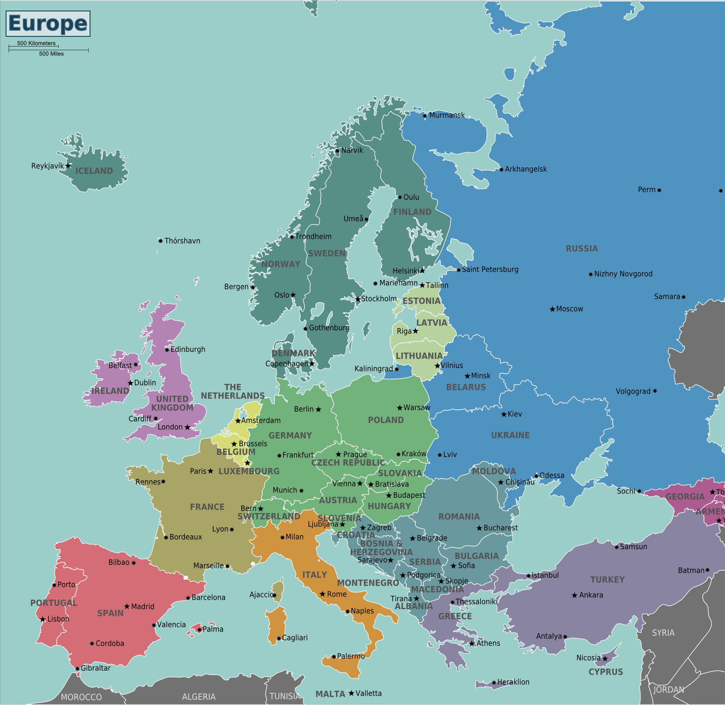
Role of the Council members (1)
Council members are expected to:
act as a link between the members in their country and the EAHIL
participate in all Council meetings
exchange ideas and experiences
be involved in activities of the committees and working groups
engage with their country members in between the EAHIL events (e.g webinars, online discussions)
expected to pass on the important information, in some circumstances even in local languages, to facilitate and reinforce communication.
This Photo by Unknown Author is licensed under CC BY-SA

Slide 4
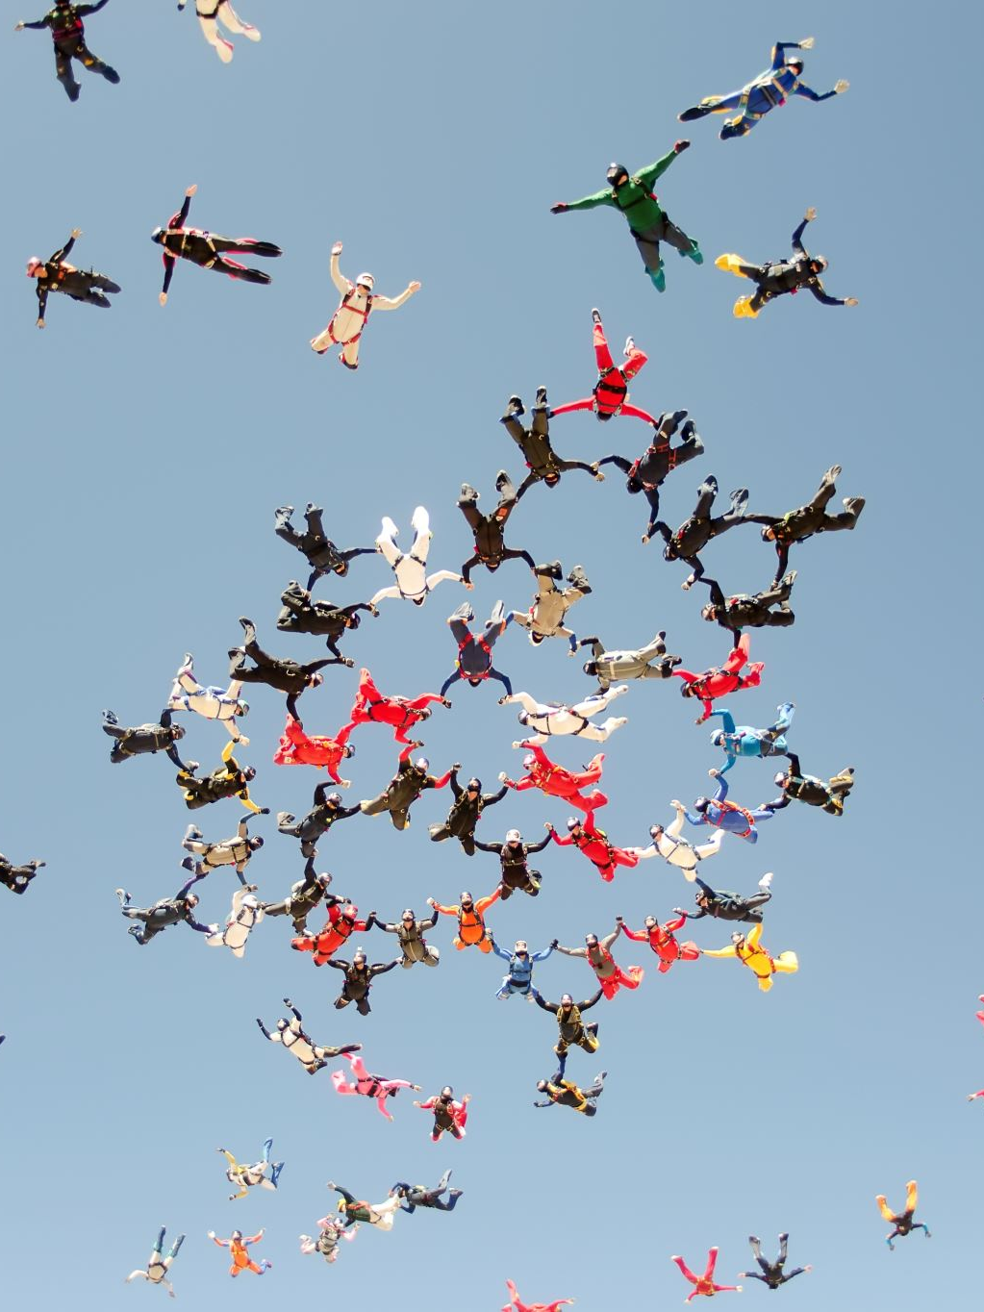
Role of the Council member (2)
Council members should encourage their members to:
attend and participate in EAHIL workshops and conferences.
attend the EAHIL General Assembly at an EAHIL events.
encourage their members to submit content to JEAHIL and EAHIL blogs.
get involved in EAHIL SIGS
consider arranging future workshops and conferences.

Slide 5
“Librarians are almost always very helpful and often almost absurdly knowledgeable. Their skills are probably underestimated and largely underemployed.”
― Charles Medawar, The Social Audit Consumer Handbook: A Guide to the Social Responsibilities of Business to the Consumer
MKM 2024

